Slide 1
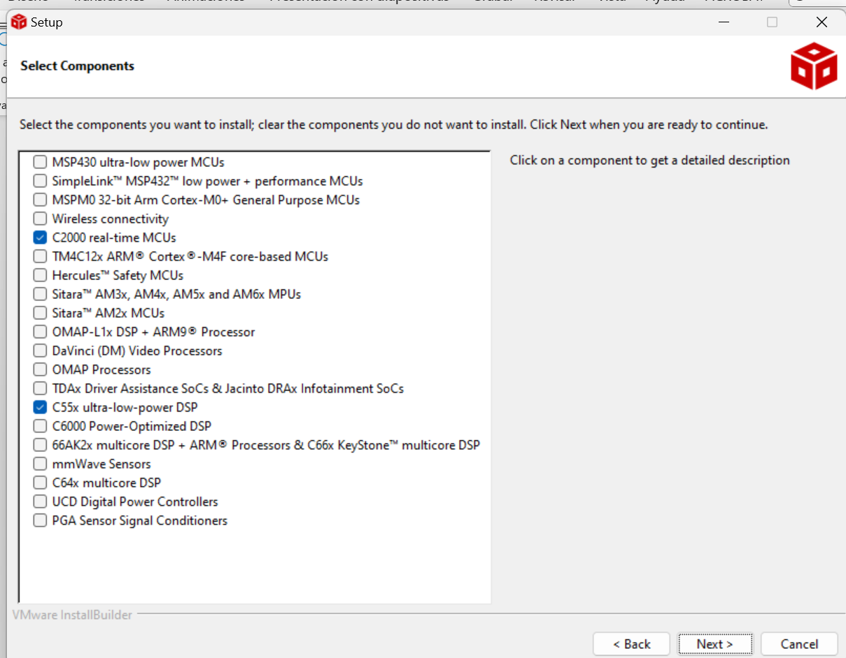
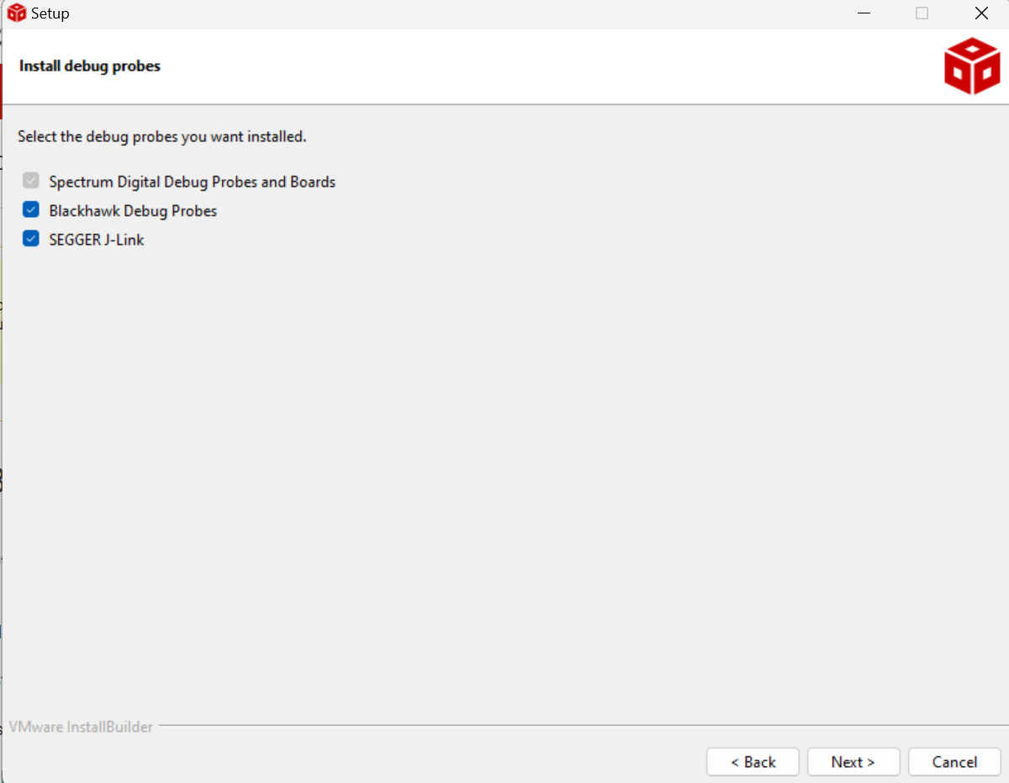
Code composer studio installation
Run ccs_setup_12.7.1.00001 in windows 64 bits
Accept and next
Select the following components and debug probes

Slide 2
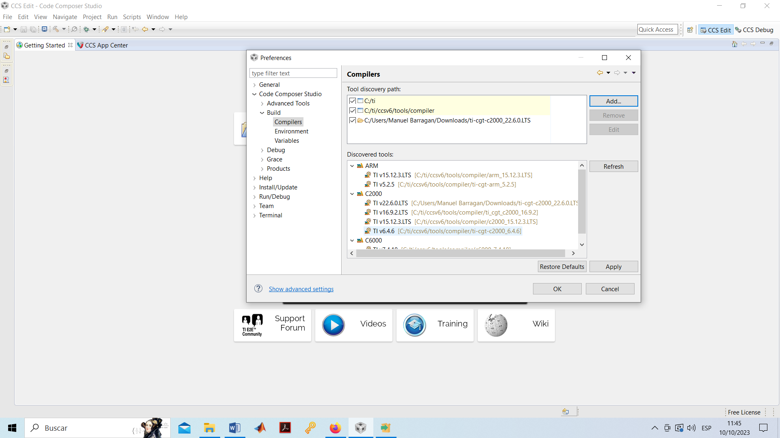
Code composer studio configuration
Download Compiler C2000v22.6
https://www.ti.com/tool/download/C2000-CGT/22.6.0.LTS
Once installed, you have to add the path where the compiler was installed:
Open Code Composer Studio 12.7.1
Window→Preferences→Code Composer Studio→Build→Compilers

Slide 3
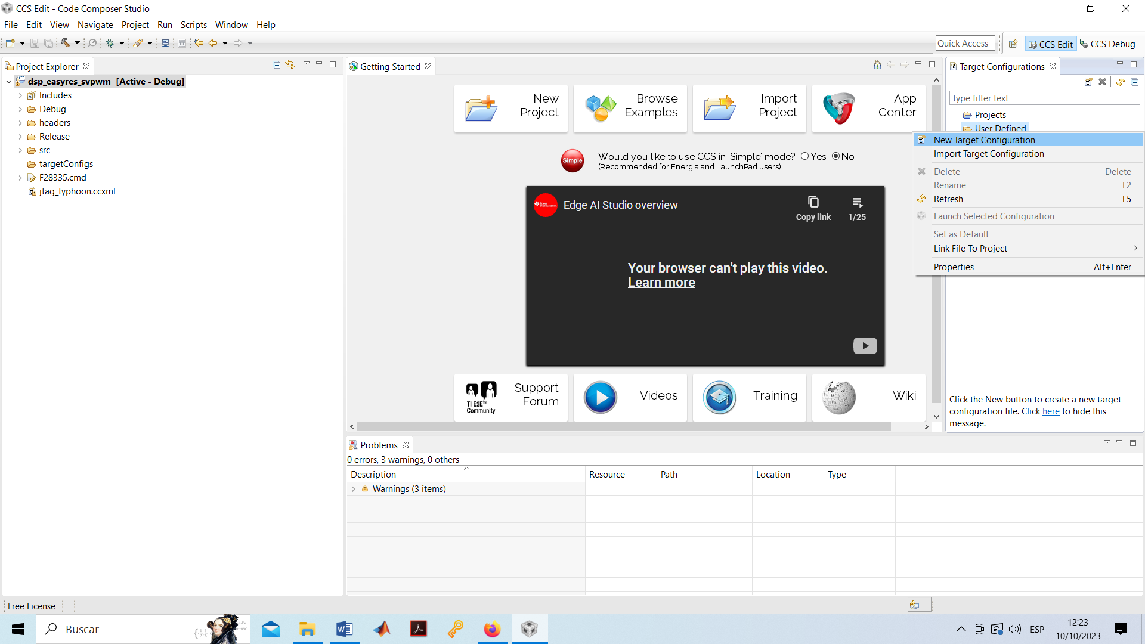
Code composer studio configuration
It's time to assign the target (DSP) and JTAG to the project (file.ccxml):
View→Target configurations
The User defined folder, a new configuration is created as follows:

Slide 4
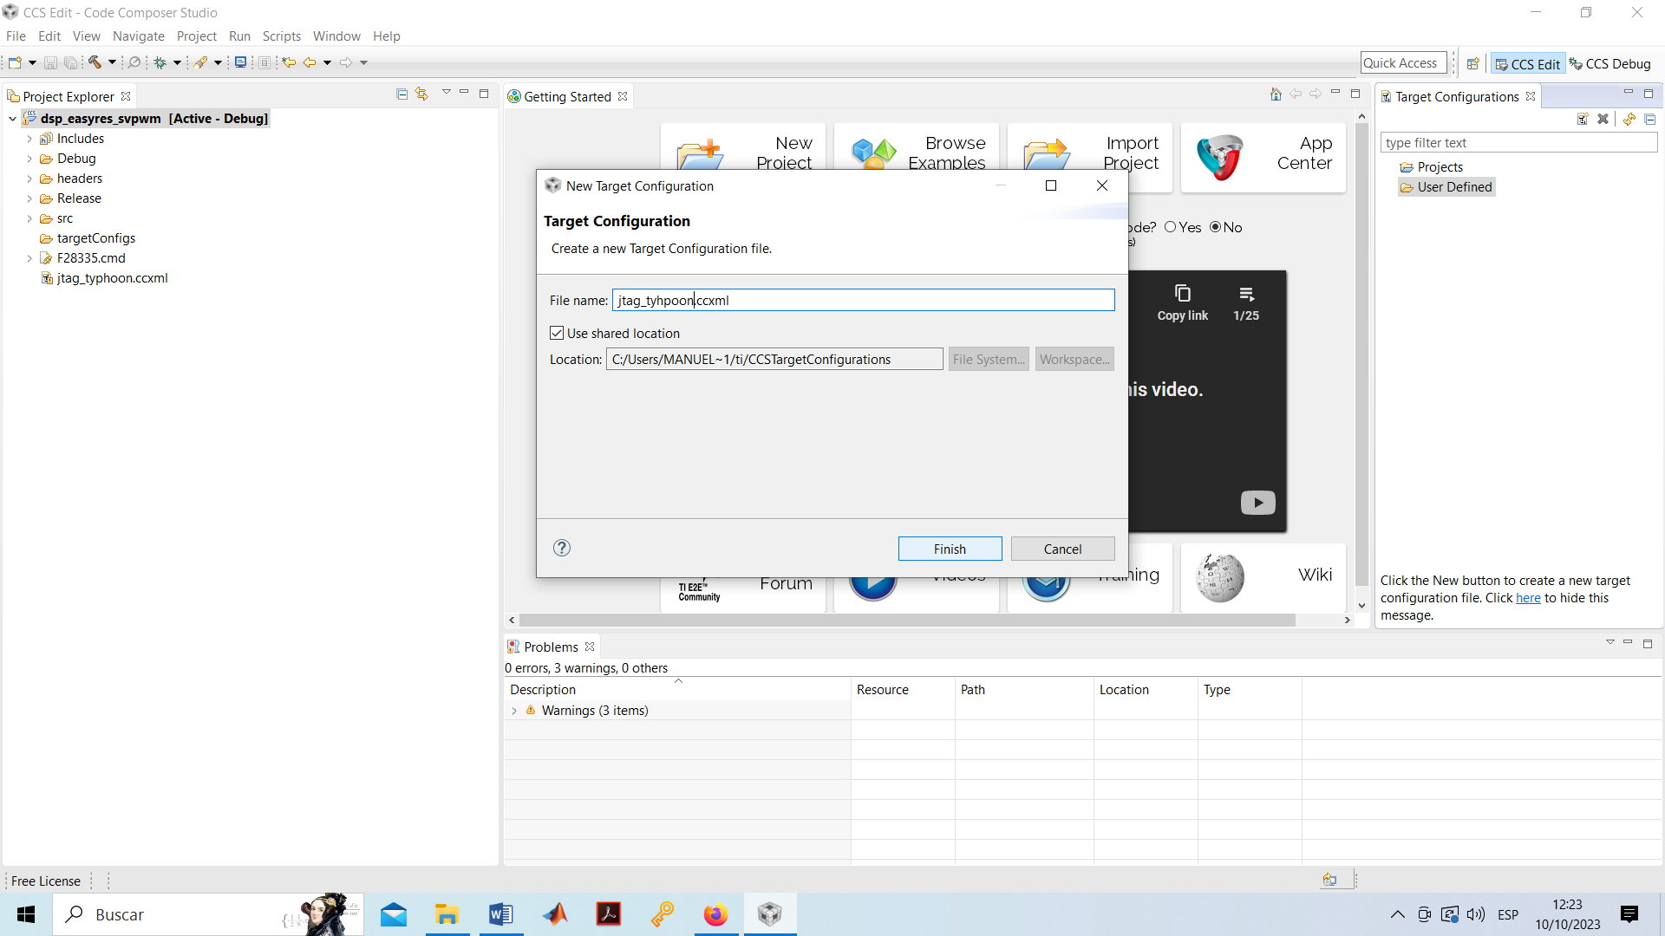
Code composer studio configuration
It's time to assign the target (DSP) and JTAG to the project (file.ccxml):
View→Target configurations
The User defined folder, a new configuration is created as follows:

Slide 5
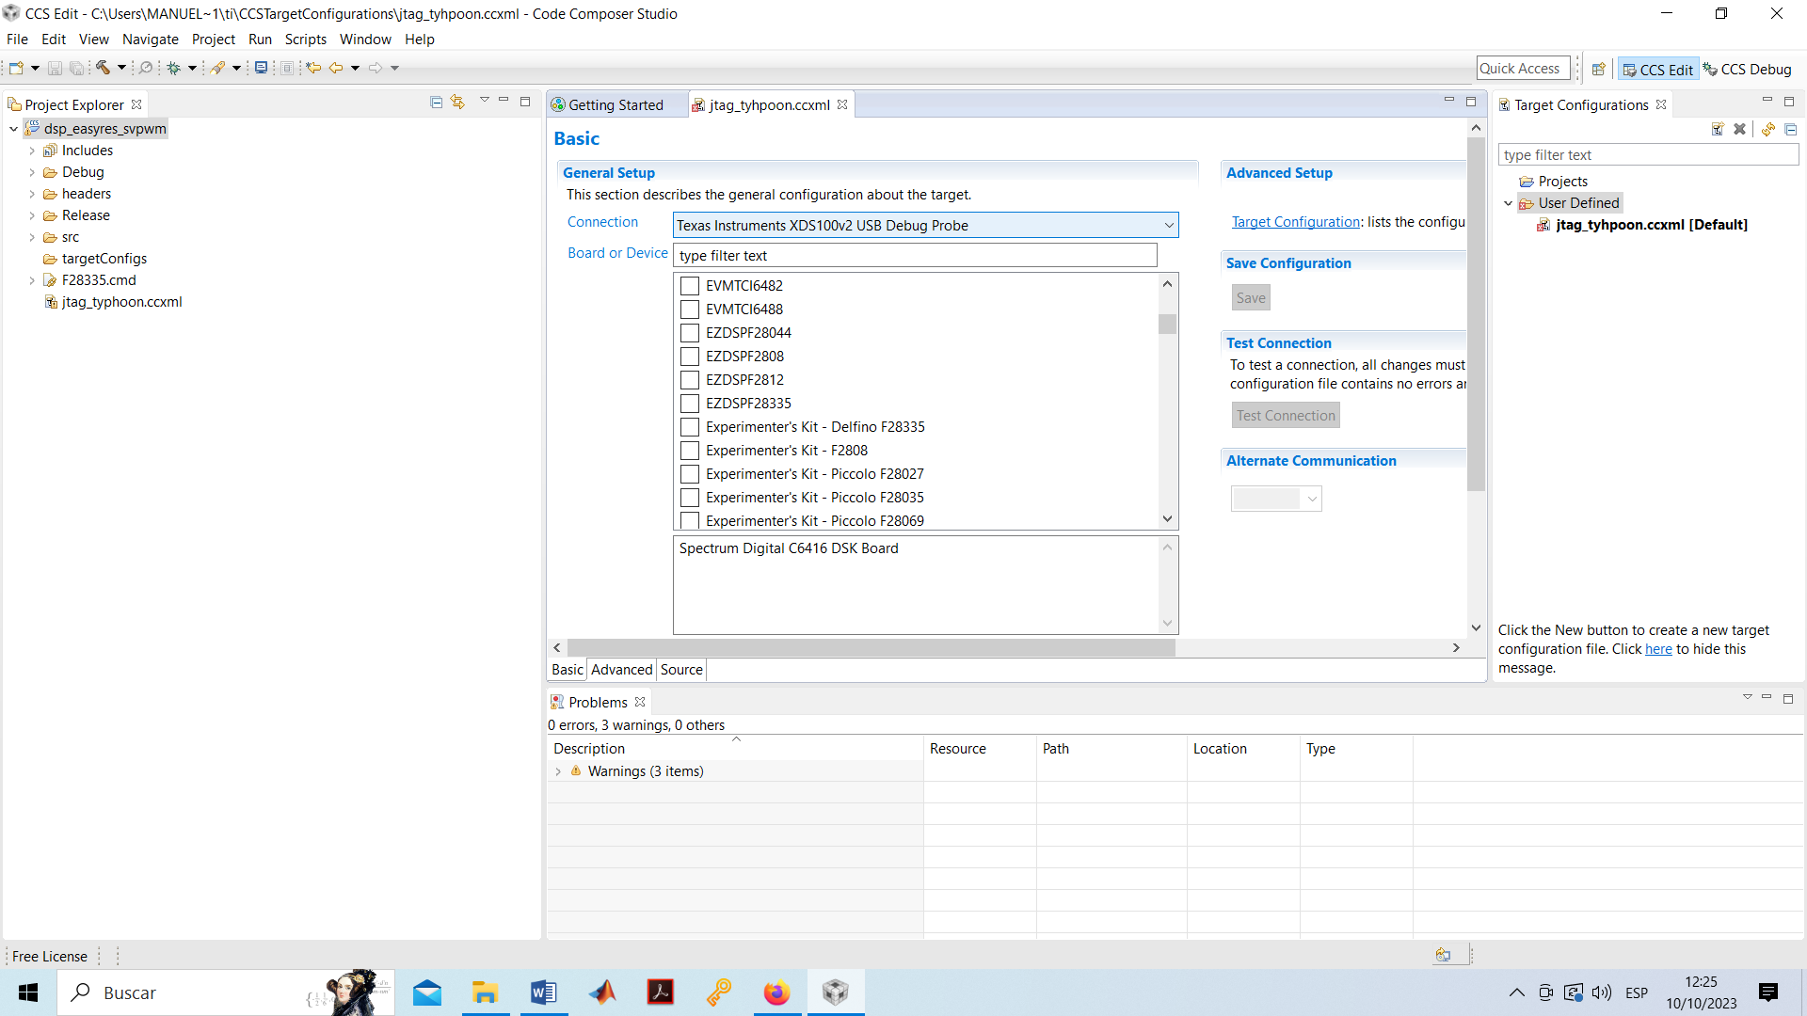
Code composer studio configuration
It's time to assign the target (DSP) and JTAG to the project (file.ccxml):
It is then linked to the desired JTAG. For F28335, the following is selected with Typhoon HIL 402:

Slide 6
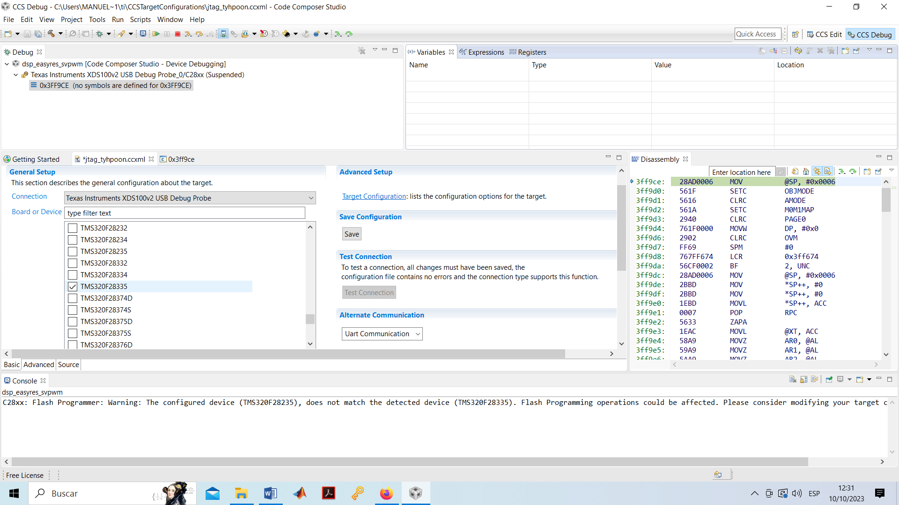
Code composer studio configuration
It's time to assign the target (DSP) and JTAG to the project (file.ccxml):
DSP is chosen:

Slide 7
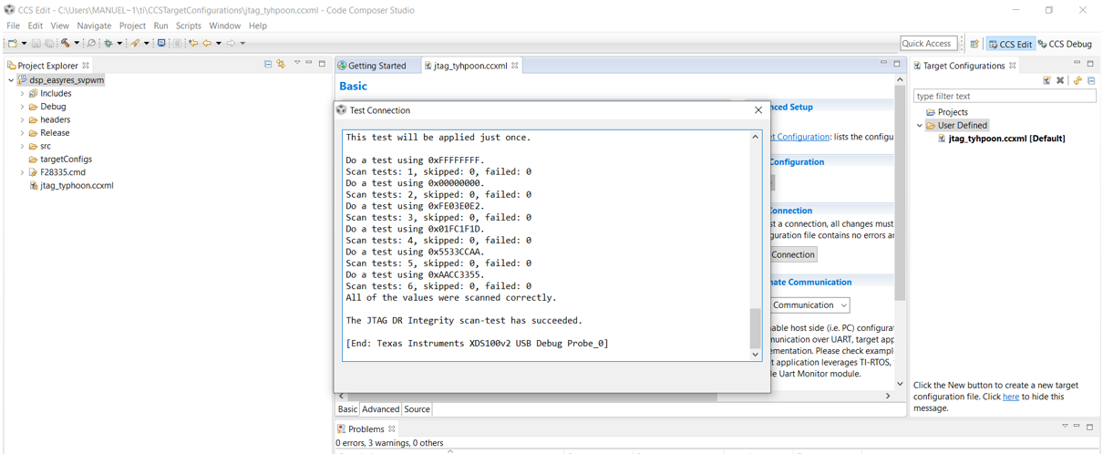
Code composer studio configuration
It's time to assign the target (DSP) and JTAG to the project (file.ccxml):
Next a Test Connection is performed. DSP must be connected through USB to the PC. It is configured correctly if this message appears:

Slide 8
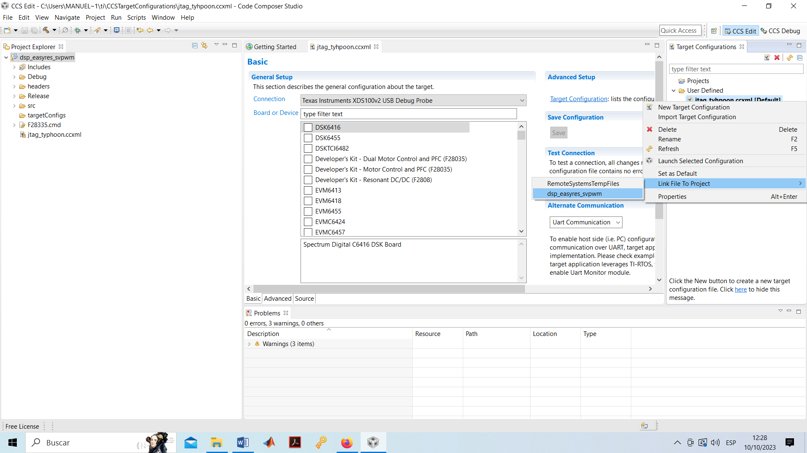
Code composer studio configuration
It's time to assign the target (DSP) and JTAG to the project (file.ccxml):
This configuration must be associated with the project. To do this, in the user defined folder with the configuration file, link to the desired project.

Slide 9
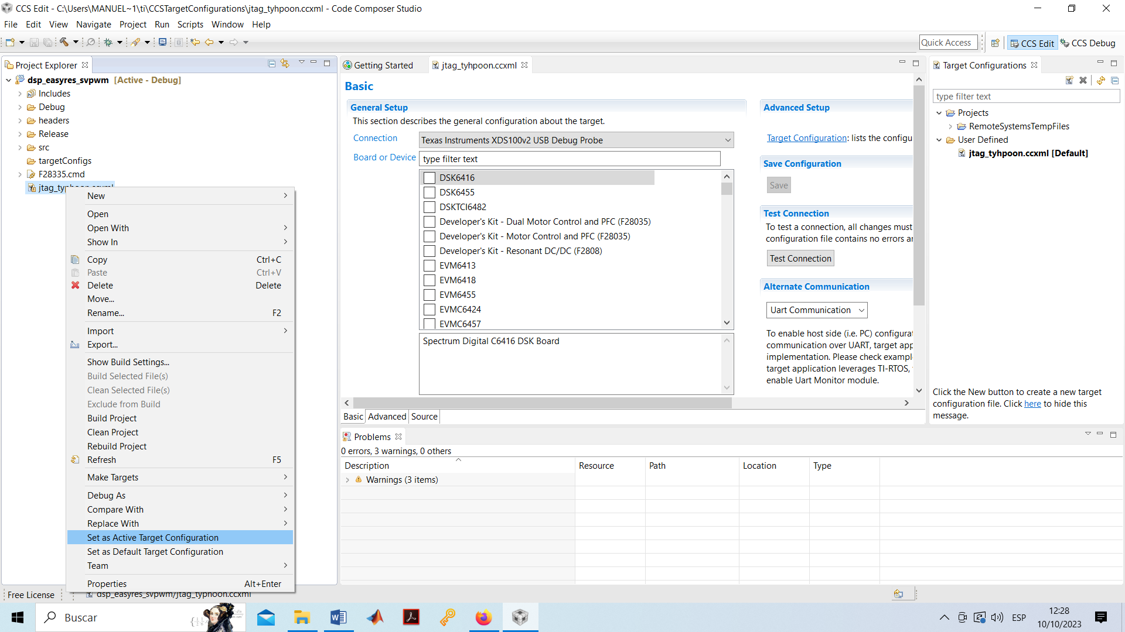
Code composer studio configuration
It's time to assign the target (DSP) and JTAG to the project (file.ccxml):
Once linked it is activated:

Slide 10
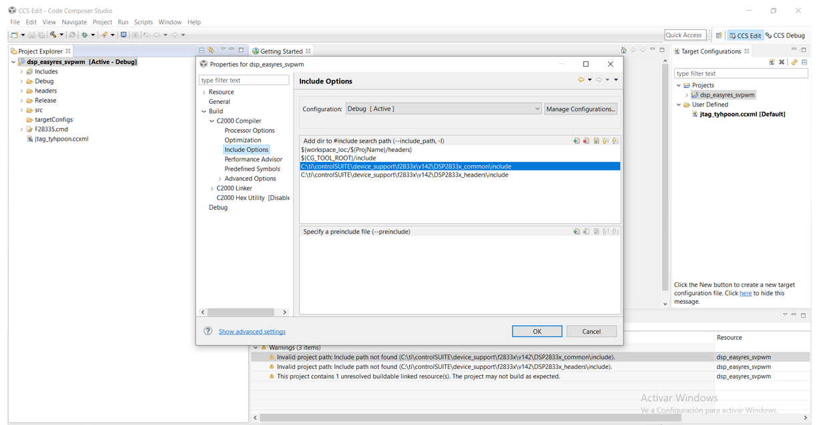
Code composer studio configuration
Next, you must install the controlsuite that configures DSP properties.
Normally, you install it in the indicated path, but if you have to do it manually, it is done in the following project preferences option:

Slide 11
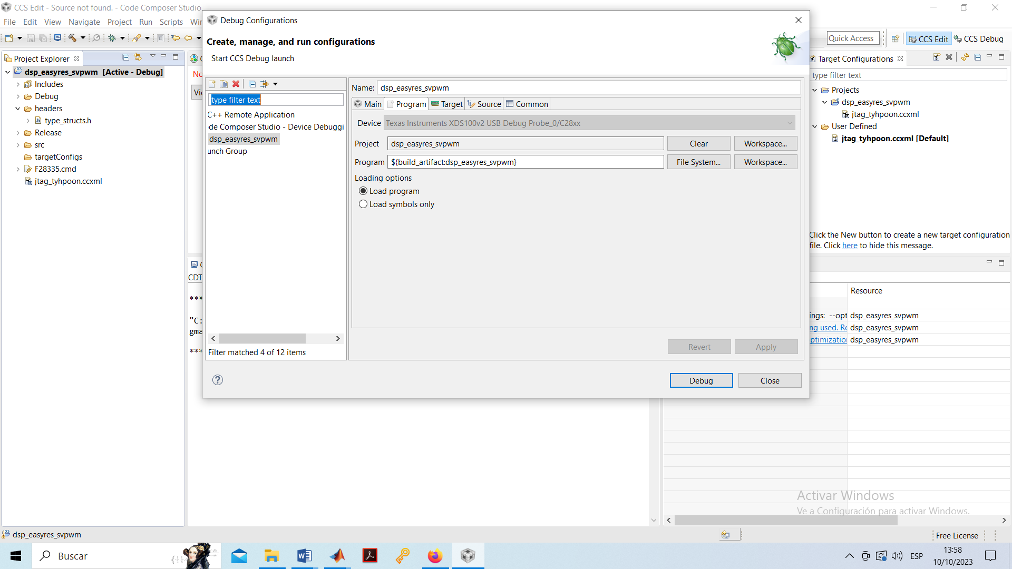
Code composer studio configuration
Configure debug options. Go to debug configurations and select the appropriate workspace for the project in program.

